Slide 1


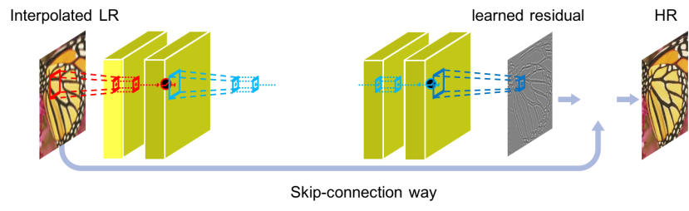




Accurate Image Super-Resolution using Very Deep Convolutional Networks
Jiwon Kim, Jung Kwon Lee, and Kyoung Mu Lee
Computer Vision Lab.
Dept. of ECE, ASRI
Seoul National University
http://cv.snu.ac.kr

Slide 2
Introduction to
Super-Resolution Problem

Slide 3

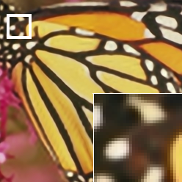

Want to make my image Big & Sharp !
Big but Blurry
Big & Sharp
Small
Super-Resolution

Slide 4
Problem statement
Single-Image Super-Resolution (SISR):
Enlarge an image with details recovered
Estimate high-frequency information (i.e. edges, texture) that are lost
Severely ill-posed inverse problem (many possible solutions)
Algorithms should exploit contextual information
Very challenging

Slide 5
Old but Still Hot
148,000 publications for last 5 years

Slide 6
Related Works:
Conventional approaches

Slide 7
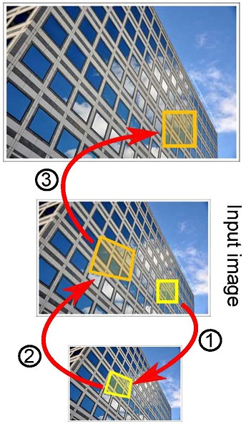


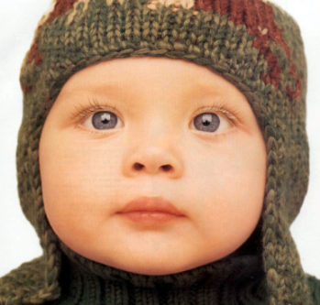
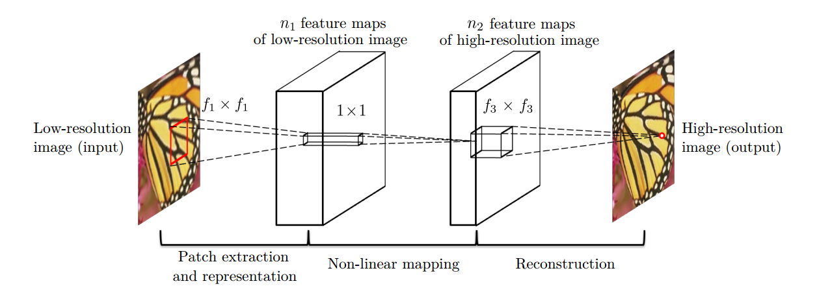
Conventional SISR methods
Self Similarity based method
Dictionary-learning based method
1
3
2
Jia-bin Huang et al. Single image Super-Resoltuion from Transformed Self-Exemplars, CVPR 2015
(SelfEx)
R. Timofte et al., A+: Adjusted anchored neighborhood regression for fast super-resoltuion, ACCV 2014
(A+)
Deep learning based method
C. Dong et al. , Learning a deep convolutional network for image super-resolution, ECCV 2014
(SRCNN)

Slide 8
Our Approach

Slide 9
Motivation
We found limitations in three aspects from existing SR methods (especially, from SRCNN)
Relies on the context of small image regions
SRCNN has only 3 layers (receptive field of 13x13), other methods use even smaller regions
Training converges too slowly
SRCNN uses learning rate of 10⁻⁵. It takes several days to converge
Works for only a single scale
Most existing methods handle different upscaling problem independently

Slide 10


Our Approach for Context
Utilize contextual information spread over very large image regions
For a large scale factor, we need to see more
We employ very deep CNN model
To keep pixel-wise info., avoid pooling
Interpolated LR
HR

Slide 11


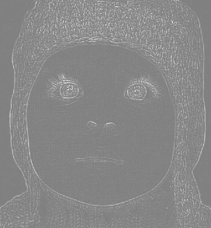



Our Approach for fast convergence
Residual image learning
Gradient clipping
Learn
Very sparse!
High resolution (HR)
Low resolution (LR)
clipped gradient flow
L2 loss
Conv / ReLu layer(s)

Slide 12



Our Approach for Scales
Train a single convolutional network to learn and handle multi-scale SR
Different scale helps each other !
Learns to upscale with inter-scale factor !
x2
20 layers
x3
x4
Our VDSR model

Slide 13
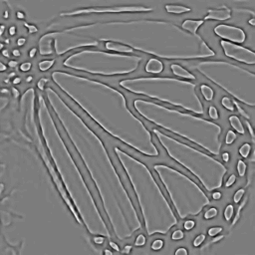
Proposed model
Interpolated LR
Conv.1
ReLu.1
Conv.D-1
ReLu.D-1
learned residual
HR
Skip-connection way
Exploits very deep CNN to SR
20 convolutional layers (41x41 receptive field)
64 channels, 3x3 filters in each convolutional layer
Skip connection to learn residual only
No dimension reduction such as pooling

Slide 14
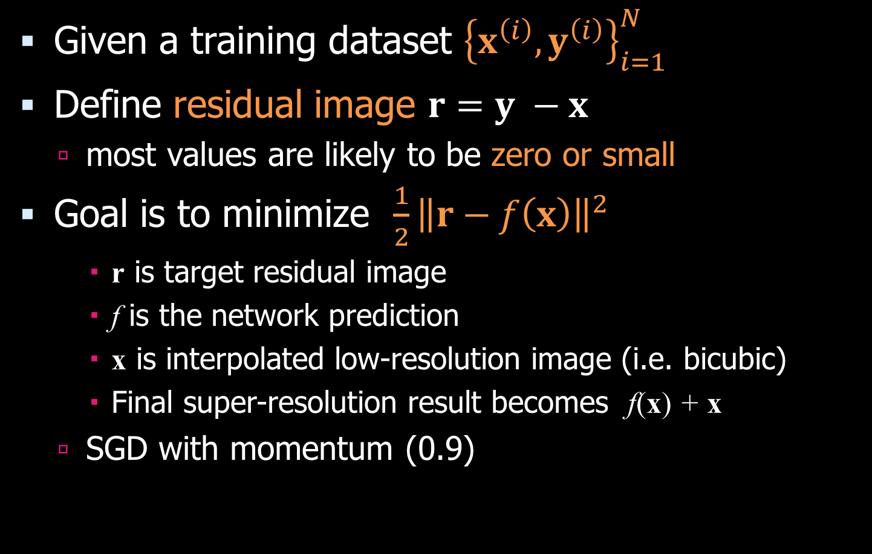
Training details Residual learning
Given a training dataset ${\left\{x^{\left(i\right)}, y^{\left(i\right)}\right\}}_{i=1}^{N}$
Define residual image $r=y −x$
most values are likely to be zero or small
Goal is to minimize $\frac{1}{2}{\left\|r−f\left(x\right)\right\|}^{2}$
r is target residual image
f is the network prediction
x is interpolated low-resolution image (i.e. bicubic)
Final super-resolution result becomes f(x) + x
SGD with momentum (0.9)

Slide 15
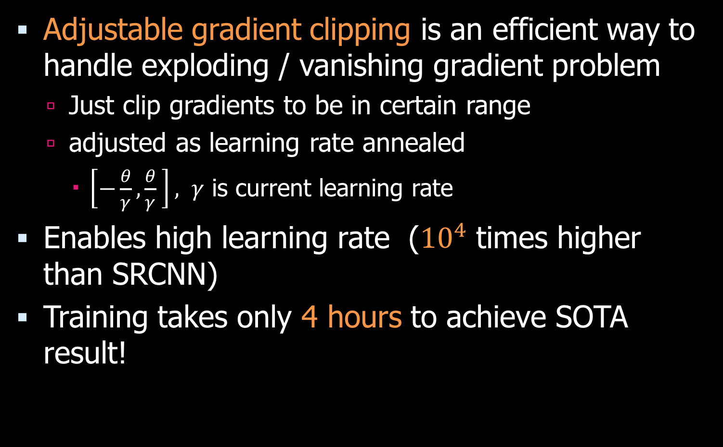
Training details Adjustable Gradient Clipping
Adjustable gradient clipping is an efficient way to handle exploding / vanishing gradient problem
Just clip gradients to be in certain range
adjusted as learning rate annealed
$\left[−\frac{θ}{γ},\frac{θ}{γ} \right], γ$ is current learning rate
Enables high learning rate (${10}^{4}$ times higher than SRCNN)
Training takes only 4 hours to achieve SOTA result!

Slide 16
Experimental Results

Slide 17
Understanding Properties The deeper, the better
For depth D network
the receptive field has size (2D + 1) x (2D + 1)
Deeper depth yields more contextual information
In addition, exploit high nonlinearity
Scale factor x2
Scale factor x3
Scale factor x4

Slide 18
Understanding Properties Residual vs. non-residual learning
Residual network learns much faster and produces better results than non-residual network

Slide 19




















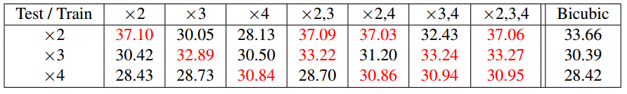










Understanding Properties One model, Multiple scales
VDSR
VDSR
$×$1.5
$×$1.5
$×$2
$×$2
$×$2.5
$×$2.5
SRCNN
$×$3
SRCNN
$×$3
$×$3.5
$×$3.5
$×$4
$×$4
Interestingly, we observe that training multiple scales
boosts the performance for large scales.

Slide 20
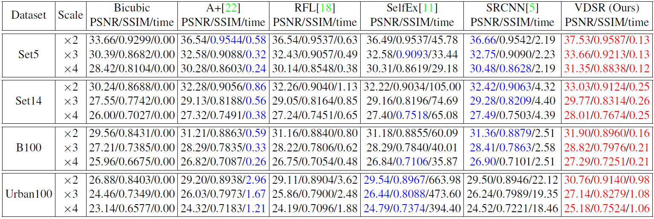
Experimental Results
Quantitative Results

Slide 21
Performance Plot

Slide 22
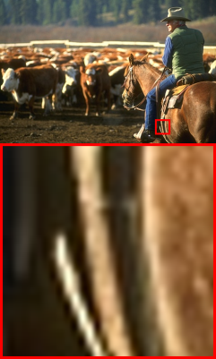
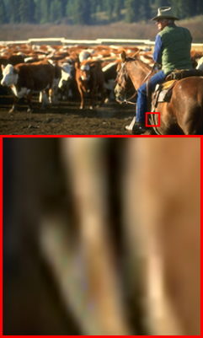

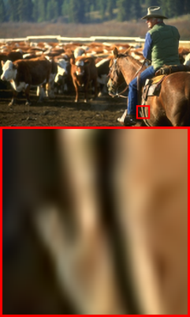








Ground truth
(PSNR/SSIM)
A+ [1]
28.44/0.8990
RFL [2]
28.42/0.8980
SelfEx [3]
28.48/0.8998
SRCNN [4]
28.84/0.9041
VDSR (ours)
29.53/0.9142
Ground truth
(PSNR/SSIM)
A+ [1]
27.38/0.7902
RFL [2]
27.27/0.7862
SelfEx [3]
27.23/0.7891
SRCNN [4]
27.53/0.7929
VDSR (ours)
28.14/0.8081

Slide 23






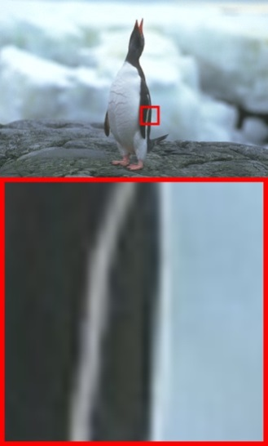





Ground truth
(PSNR/SSIM)
A+ [1]
30.00/0.7878
RFL [2]
29.86/0.7830
SelfEx [3]
29.93/0.7883
SRCNN [4]
29.98/0.7867
VDSR (ours)
30.36/0.8005
Ground truth
(PSNR/SSIM)
A+ [1]
32.76/0.8859
RFL [2]
32.65/0.8838
SelfEx [3]
32.89/0.8865
SRCNN [4]
32.99/0.8856
VDSR (ours)
33.77/0.8938

Slide 24
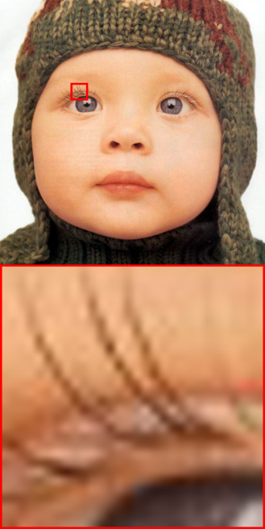
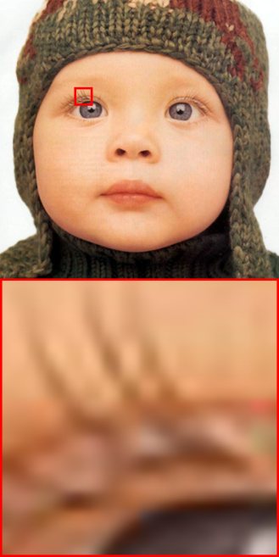










Ground truth
(PSNR/SSIM)
A+ [1]
38.52/0.9651
RFL [2]
38.51/0.9650
SelfEx [3]
38.44/0.9644
SRCNN [4]
38.54/0.9655
VDSR (ours)
38.75/0.9667
Ground truth
(PSNR/SSIM)
A+ [1]
34.29/0.9400
RFL [2]
33.90/0.9372
SelfEx [3]
34.21/0.9389
SRCNN [4]
33.81/0.9374
VDSR (ours)
34.99/0.9484

Slide 25
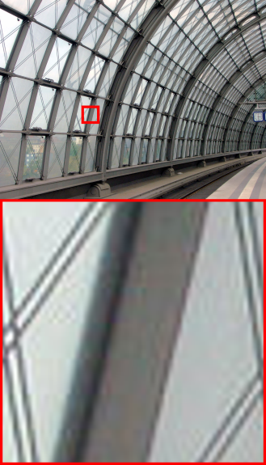






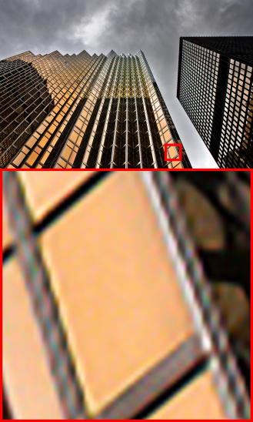

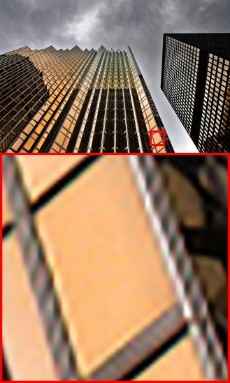
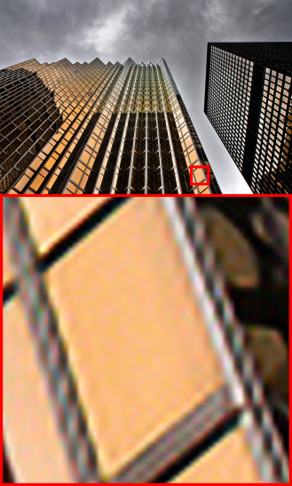

Ground truth
(PSNR/SSIM)
A+ [1]
30.09/0.9237
RFL [2]
29.90/0.9186
SelfEx [3]
30.40/0.9240
SRCNN [4]
30.43/0.9226
VDSR (ours)
32.46/0.9476
Ground truth
(PSNR/SSIM)
A+ [1]
24.90/0.9076
RFL [2]
24.92/0.9048
SelfEx [3]
26.03/0.9182
SRCNN [4]
25.75/0.9135
VDSR (ours)
26.94/0.9311

Slide 26

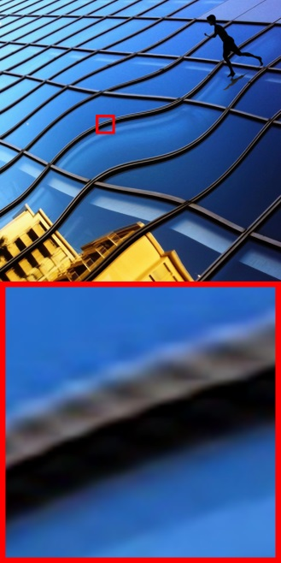










Ground truth
(PSNR/SSIM)
A+ [1]
29.83/0.9102
RFL [2]
29.61/0.9026
SelfEx [3]
30.73/0.9193
SRCNN [4]
29.97/0.9092
VDSR (ours)
31.35/0.9313
Ground truth
(PSNR/SSIM)
A+ [1]
26.24/0.8805
RFL [2]
26.22/0.8779
SelfEx [3]
26.90/0.8953
SRCNN [4]
26.40/0.8844
VDSR (ours)
27.06/0.9052

Slide 27











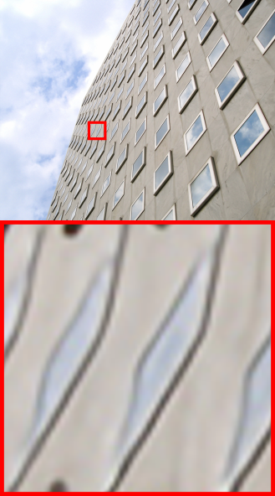
Ground truth
(PSNR/SSIM)
A+ [1]
25.04/0.7465
RFL [2]
24.94/0.7394
SelfEx [3]
25.39/0.7637
SRCNN [4]
25.00/0.7448
VDSR (ours)
25.66/0.7768
Ground truth
(PSNR/SSIM)
A+ [1]
26.15/0.8692
RFL [2]
25.79/0.8588
SelfEx [3]
26.33/0.8733
SRCNN [4]
26.39/0.8684
VDSR (ours)
28.18/0.9073

Slide 28












Ground truth
(PSNR/SSIM)
A+ [1]
25.78/0.8330
RFL [2]
25.69/0.8289
SelfEx [3]
25.89/0.8365
SRCNN [4]
25.93/0.8363
VDSR (ours)
26.91/0.8695
Ground truth
(PSNR/SSIM)
A+ [1]
22.84/0.9058
RFL [2]
22.77/0.9037
SelfEx [3]
22.89/0.9028
SRCNN [4]
23.54/0.9162
VDSR (ours)
25.13/0.9439

Slide 29
Conclusion

Slide 30
Conclusion
Single image Super-resolution method using very deep neural networks
With residual learning and extremely high learning rate using gradient clipping, we train the system very fast
Our method outperforms other methods by a large margin

Slide 31



Slide 32
Quantitative Results
*cpu version

Slide 33
Performance Plot
DRCN

